Slide 1
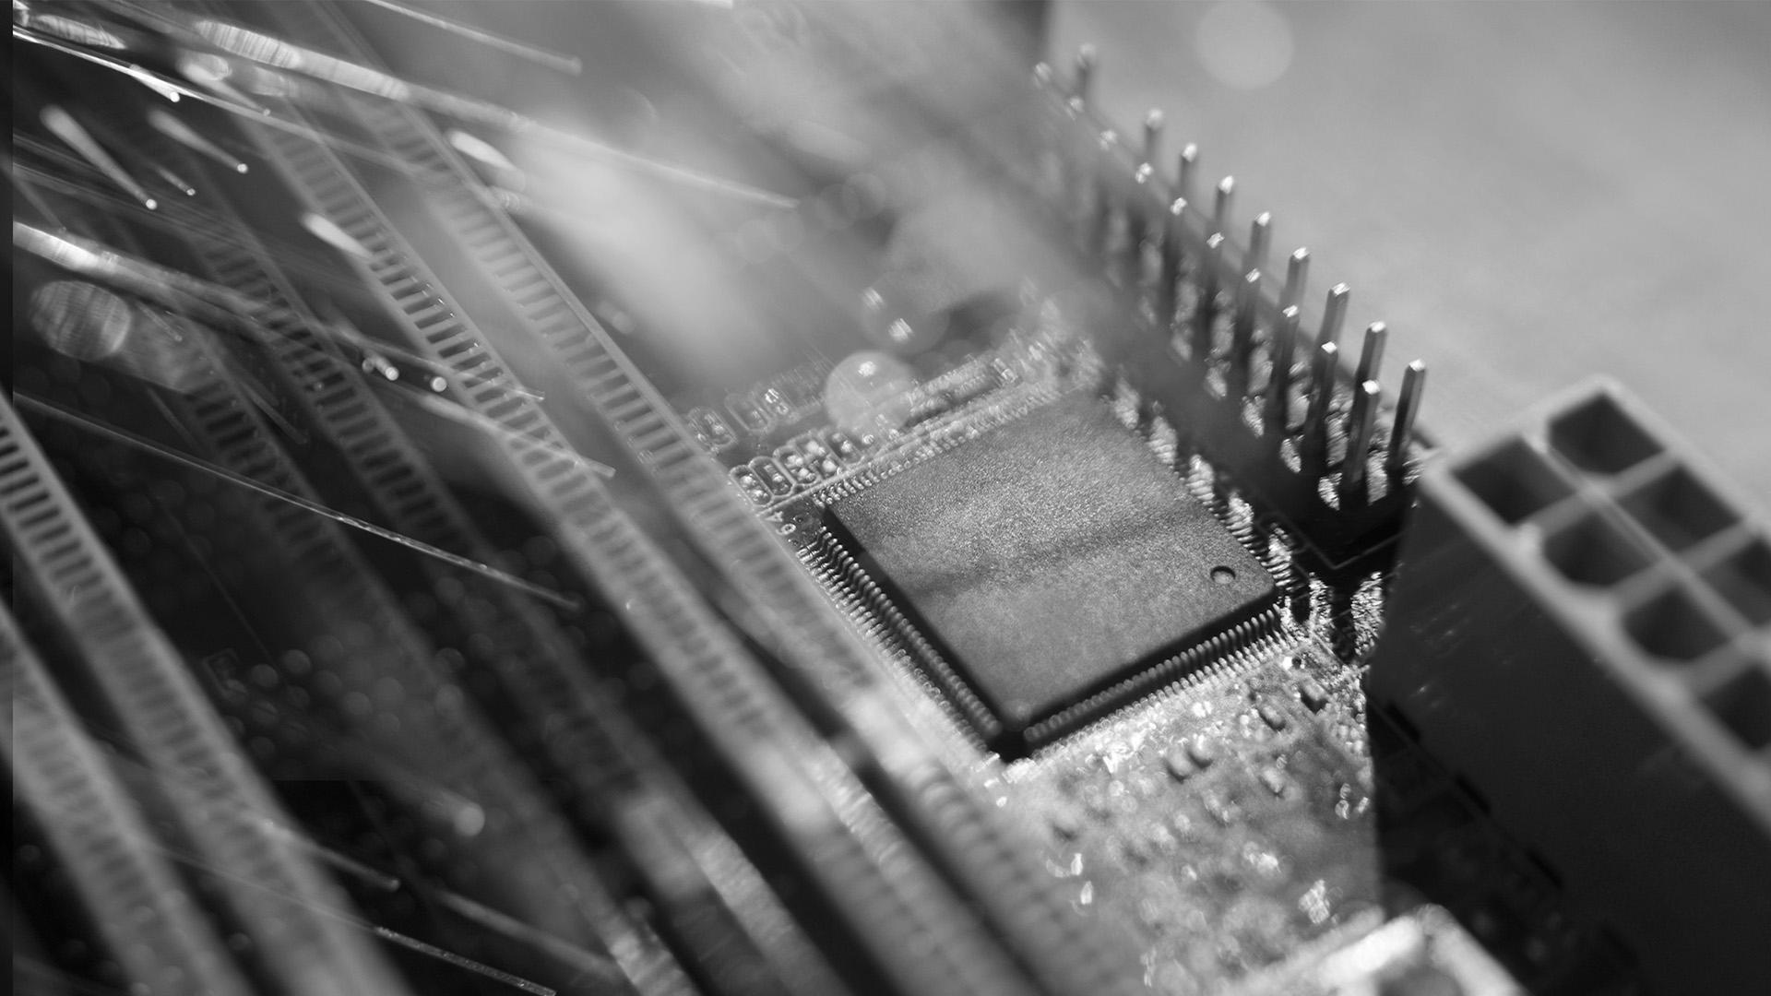
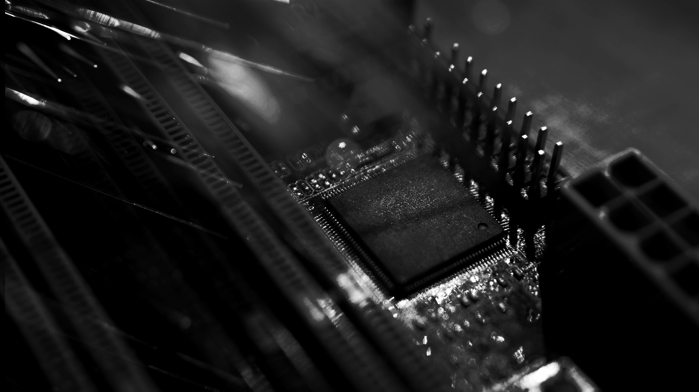
When FRODO Flips
Fahr et al. 2022
Manasi Singhane
Pawan K. Pradhan

Slide 2
INTRODUCTION
01
BACKGROUND
02
OVERVIEW OF ATTACKS
TABLE OF CONTENTS
03
KEY RECOVERY
04
POSSIBLE COUNTERMEASURES
05
How resilient are PQC KEM against Rowhammer attacks
Rowhammer Attack
FrodoKEM
Various Attacks & techniques involved alongside their complications and how to tackle them
Generating Ciphertexts
FrodoKEM Key Recovery
Session-Key Recovery
Rowhammer Defenses

Slide 3
01
Introduction

Slide 4
Memory Hierarchy
Registers
Cache
RAM
Disk
Short term (fast access)
Long term (slow access)

Slide 5
Memory
Memory stored in a matrix
DRAM is implemented with capacitor and transistor
Capacitor charge = bit value
Can load a “row” into DRAM
Memory is continuously refreshed

Slide 6
02
BACKGROUND

Slide 7
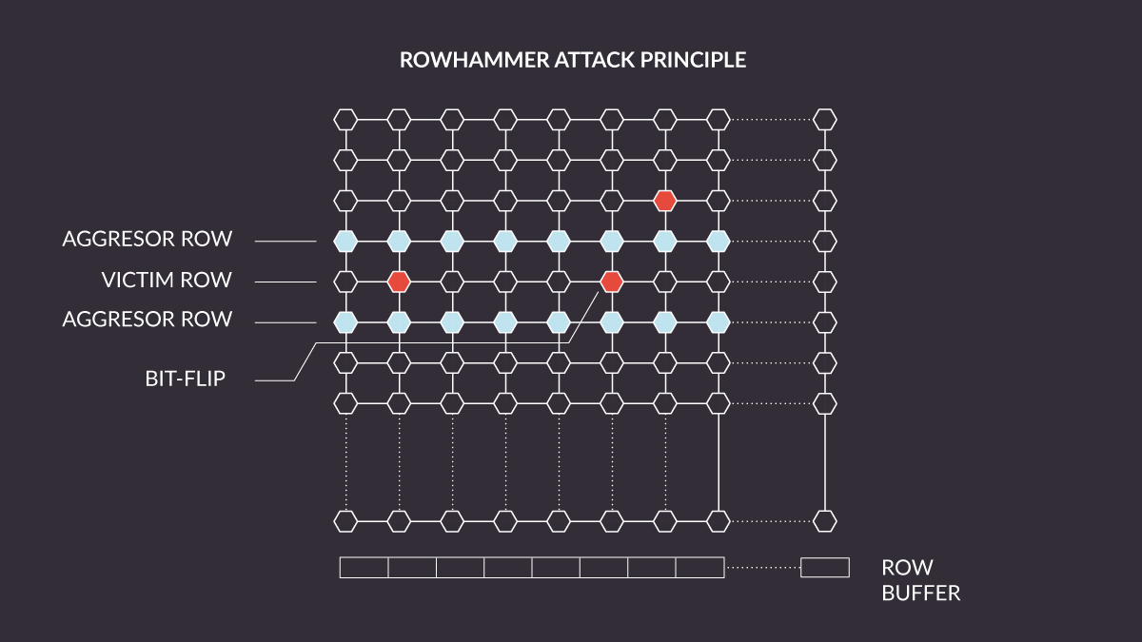
Rowhammer Attack
Repeated access to the same row can flip bits in adjacent rows
Repeated access causes voltage build up
Voltage build up → disturbance errors in nearby rows = bit flip
Double Sided rowhammer: accesses rows above + below
Repeatability of flips: A bit that flips is likely to flip again

Slide 8
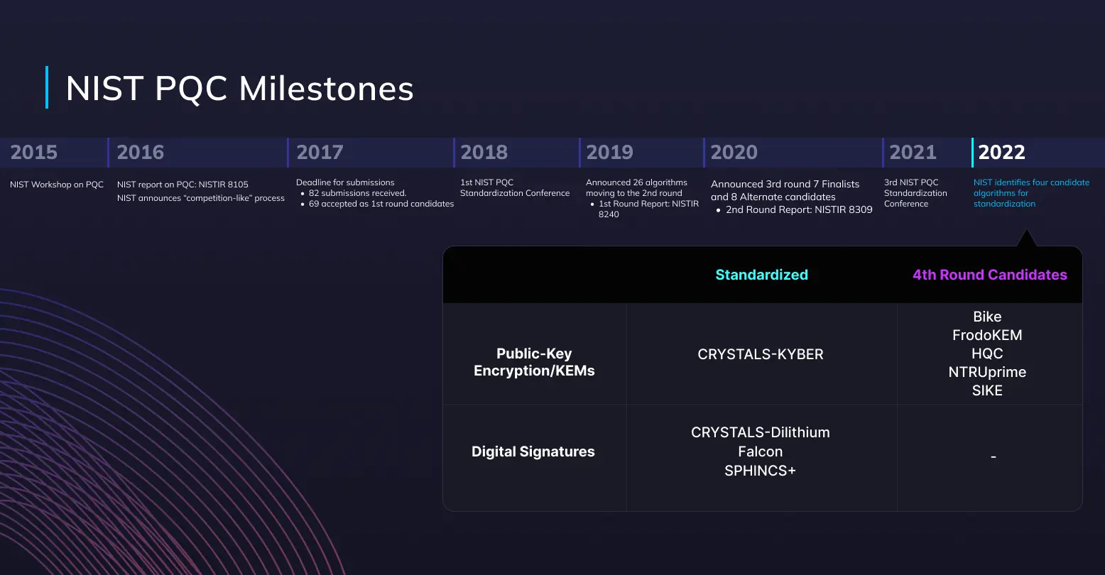
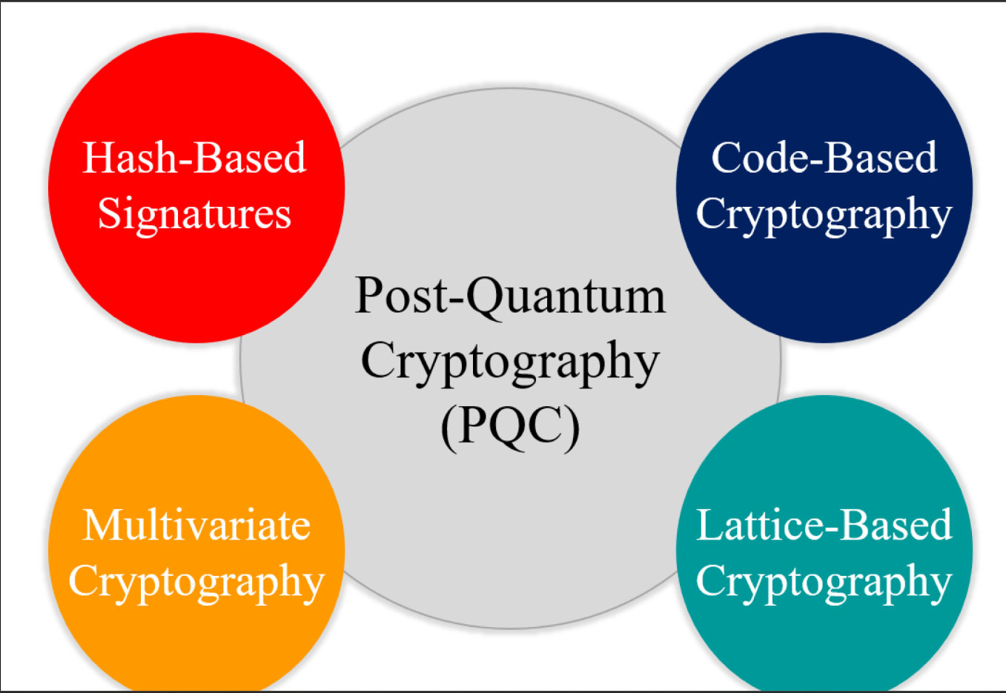

NIST PQC Milestones, Standardized Algorithms and 4th Round Candidates

Slide 9
KEM from PKE
Public Key Encryption Scheme (PKE)
Def: A PKE is a tuple of algorithms:
KeyGen() - Outputs (pk,sk) | Public Key = pk ; Secret Key = sk
Enc(pk,µ) - takes inputs public key pk & message µ and outputs ciphertext c.
Dec(sk,c) takes input as secret key sk and ciphertext c and outputs message µ or fails.

Slide 10
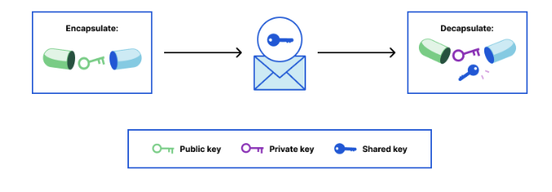
Key Encapsulation Mechanism (KEM)
Def: A KEM is a tuple of algorithms:
KeyGen() - Outputs (pk,sk) | Public Key = pk ; Secret Key = sk
Encap(pk) - takes inputs public key pk & outputs(c,k), where c=ciphertext and k=shared key.
Decap(sk,c) takes input as secret key sk and ciphertext c and outputs a shared session key or fails.
Notes:
A public-key encryption scheme is correct if an honest in-order execution of KeyGen, Enc, Dec, results in Dec outputting the same message that is input into Enc (with overwhelming probability)
A public-key encryption is IND-CPA if any adversary cannot distinguish between ciphertexts of two adversarially-chosen messages with non-negligible advantage
A key-encapsulation mechanism is correct if an honest in-order execution of KeyGen, Enc, and Dec results in the same shared session key output by Encap & Decap (with overwhelming probability)
A KEM is IND-CCA if any adversary with access to a decapsulation oracle, on input of a random challenge session key and a challenge ciphertext, cannot distinguish between the case when the session key is encapsulated in the ciphertext and the case when the session key is independent and uniformly random, with non-negligible advantage

Slide 11
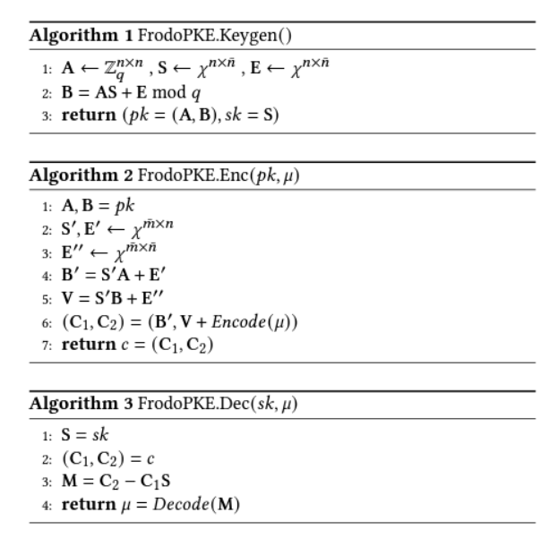
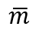
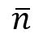
FrodoPKE
This is a high level description of FrodoPKE in Algo. 1, 2 & 3.
In this algorithms, n, , , B & q are integer parameters. Specifically for Frodo640:
n=640 , = = 8, B =2, and q=32768 = 2¹⁵
The Encode() function encodes an integer an integer k such that 0 ≤ k＜2^B ≤ q as an element in Zq:
Encode(k) := k.q/2^B
The Decode() function extracts a B-bit integer from an element in Zq:
Decode(c) := ⌊𝑐 · 2^𝐵/𝑞⌉ mod 2^𝐵.
This Encode and Decode functions have a error correcting property.

Slide 12
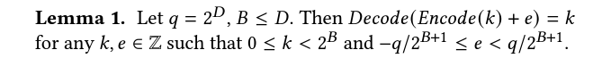
The correctness of FrodoPKE follows because the decryption computes:
M = C₂ - C₁S
= V + Encode(μ) - B’S
= Encode(μ) + S’B + E’’ - (S’A + E’)S
= Encode(μ) + S’(A.S + E) + E’’ - S’AS - E’S
= Encode(μ) + S’A.S + S’E + E’’ - S’AS - E’S
= Encode(μ) + S’E - E’S + E’’ = Encode(μ) + E’’’ [E’’’ = S’E - E’S + E’’]
If entries E’’’ is sufficiently small, Decode(M) = μ
If an entry in the decoding error E’’’ exceeds the threshold [ -q/2^B+1 , +q/2^B+1 ), a decoding error will occur

Slide 13
FrodoKEM
Bob
Alice
pk = A, AS +E
Generates
B = AS + E
Return (pk(A,B),sk(S))
c= FrodoPKE.Enc(pk, u;r)
Runs
u $ {0,1}^{d}
r = H(u)
C = FrodoPKE.Enc(pk, u;r)
Runs
Decrypts c → u
Computes H(u) = r
Compute c ‘ = FrodoPKE.Enc(pk, u;r)
If c’ = c → Success
Else fails
Essentially applying the FO transform.
Notes:
Essentially FO transform

Slide 14
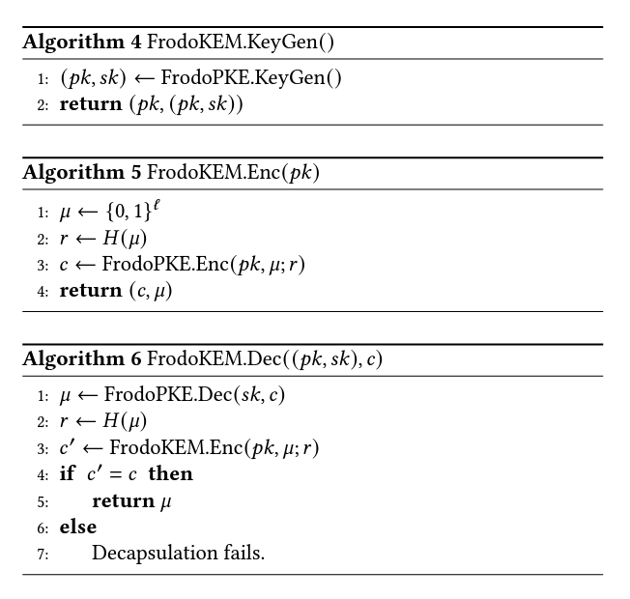
For the attack we will again consider the following parameter set of Frodo640:
n=640
B =2
q = 2¹⁵
Decoding threshold is [-4096,4096) given q/2^{B+1}.
Notes:
A high level description of FO transform used by FrodoKEM in shown aside in Algo. 4, 5 & 6, where H is a cryptographic Hash Function(e.g. SHAKE) modeled as random oracle.

Slide 15
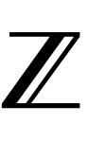
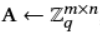
FrodoKEM is an IND-CCa key-encapsulation mechanism.
It is constructed as a Fujisaki-Okamoto transform of FrodoPKE, an IND-CPA public-key encryption whose security is based on the hardness of basic LWE .
LWE Distribution
Def: The LWE Distribution is parameterized by positive integers (m,n,q) and an error distribution 𝜒 over The LWE Distribution is sampled by sampling:
a uniformly random A,
a uniformly random S,
a uniformly random E.
and outputting (A, b:= As + e mod q)

Slide 16
03
Overview of Attacks

Slide 17
Attack Overview
Goal: Recover the shared key by flipping bits of the LWE secret key via flipping bits of the error matrix E’’’
Use the Rowhammer attack to poison FrodoKEM’s KeyGen() process.
Use a super-computer to extract the private-key material from it.
Parse data using for key-recovery algorithm.
Recover the shared key (can be done on a laptop!)
Notes:
Note: This whole work is set up in the scenario of running a lattice KEM’s KeyGen in a cloud computing environment, where an adversary will have access to a common, shared memory architecture on which the honest users runs KeyGen().

Slide 18
Pre-Processing for Attack
Profiling Memory: The method of doing so involves exploiting Linux’s buddy allocator to obtain 2MB of contiguous memory. After obtaining this memory, we iteratively hammer and we check the flip results on the victim row.
We store the map of flips within each page so we can use the pages which are best for the attack.
Filtering candidate pages: Error matrix has dimensions 640 x 8 of 2 bytes values, resulting in the matrix spanning 2.5 pages of size 4 KiB. Therefore, it is spread across a 3-4 pages.
The first and last page containing the error matrix might also contain other variables as well, so it is better to consider pages that contains no flip in these region.
Filter out all sets of pages that don’t provide exactly one 256-bit flip in at least 7 of the 8 columns, pages that don’t have sufficient flips, and also pages that offer too many flips in undesired location.

Slide 19
Pre-Processing for Attack
Memory Massaging: Here, we force the victim to allocate its memory in the exact pages of DRAM that we want.
Allocating pages to victim: This is achieved by exploiting the Linux Page frame cache using a technique called ‘Frame Feng Shui’. The linux frame page cache stores frames in first-in-last-out data structure, and returns the most recently deallocated page.
Firstly we will use multiple 4KiB junk pages to fill the bottom of the cache and then use our filtered out candidate pages to place it at the to the frame cache.
So whenever the victim process runs its keygen process, the FrodoKEM process request memory to store E and the linux buddy allocator will return pages chosen by the attacker.

Slide 20
Rowhammer DRAM Bug
Rowhammer is a phenomenon wherein repeated accesses to a row in DRAM can induce bit flips in the neighbouring rows.
It occurs because Dynamic RAM consists of multiple memory cells packed tightly together and specific access patterns can cause unwanted effects that propagate to nearby memory cells and cause bit-flips in cells which have not been accessed by the attacker.
This is because activations of the rows worldline causes the capacitors storing bit values in neighbouring rows to discharge slightly due to parasitic current.
A fault in many DRAM Modules, from 2010 onwards.
Bypasses memory protection: One process can affect another.

Slide 21
Memory Bit Masks: Rowhammer physically flips bits in a one-sided manner i.e. from 0 to 1 . There are two problems with this construction:
Logical bits stored in DRAM is different from the Physical bits, and every time a device boots up, a random bit mask similar to a one-time pad is applied, and for N possible pads, the attack succeeds with a probability of 1/N, if the machine is reset between profiling and attack.
2’s complement signed representation reduces the success probability as for every column that we want to do a 256-bit flip. The value prior to flip can be a negative or positive value. As a consequence, a negative value targeted to do a 256-bit flip from 0 to 1, will be unsuccessful as the value would already be 1. So each column can be attacked with a probability of ½ . And since each of these locations are independent, the overall success probability is now 2⁻ⁿ Where n is the no of columns to be poisoned on E.

Slide 22
Memory bit mask
Issue #1: The Rowhammer attack only flips bits from 0 → 1
The attack induces a charge in neighboring cells
When device boots up, random mask (one time pad) applied to bits in DRAM → attack would succeed with probability 1/N if new mask is applied after profiling
Two ways to tackle this: 1.) The attack has to be performed within a single boot session
2.)If the device reboots, we will have to re-profile our memory before keygen
Issue #2: The format used to store bits also causes a problem (signed 2’s complement)
All negative values are going to be stored as a ‘1’ bit for sign representation, so these bits cannot be flipped
Need a way to additionally filter out ciphertexts based on these problems
Notes:
Also additional problems due to memory bit mask

Slide 23
Decryption Failure Attack
Valid ciphertexts occasionally fail to decrypt
Recall LWE based KEM is approximate
Error is [E’’’ = S’E - E’S + E’’]
Information about whether the ciphertext has decrypted can allow an adversary to recover the secret key
In the case of Frodo, pk contains less information about the secret key (recall the low threshold)
However low threshold → larger fraction of decryption failures
Tradeoff between number of ciphertexts needed to extract secret key information and overall computation
Notes:
Won’t go into the decryption failure rate analysis, we defer to the paper

Slide 24
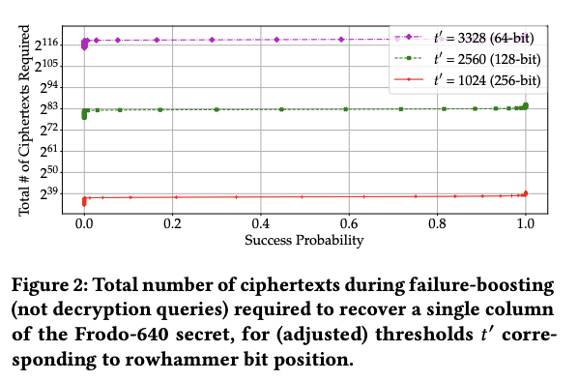
Determining the Bits to Flip
We can see here that targeting the 256 bit position requires the least ciphertexts
Notes:
Failure boosting

Slide 25
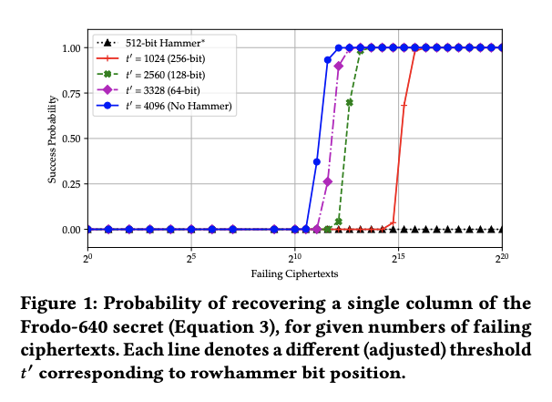

Slide 26
Key Poisoning
Row hammer attack needs to be timed perfectly and executed during execution of KeyGen():
i.e After generation of E and before it being added to AS [ B = AS + E ]
Target location in RAM where LWE public key matrix A and error matrix E are stored
E is stored as a variable
KeyGen() delayed by exploiting hash function (SHAKE 128) execution
Run performance degrading code on sibling cores while costly operations run on one core
Performance degradation repeatedly flushes cache.

Slide 27
Profiling Memory: Rowhammering is sensitive to the physical characteristics of individual DRAM modules in the victim device, decided arbitrarily due to process variation during manufacturing at a foundry.
For any given page of RAM, some bits will flip frequently when subjected to hammering, and other bits will flip only very slowly. The solution is to profile the target device (before the FrodoKEM algorithm comes online), by hammering every position in the RAM up front, to determine which bits on which pages are more likely to flip.
Memory Massaging: Here, we force the victim to allocate its memory in the exact pages of DRAM that we want, by exploiting the low-level details of the data structure underlying the allocation of Linux page frame caches.
From the above method we knew the flippy-bit’s physical location in various pages of victim DRAM device, we now want to make sure that our FrodoKEM algorithm allocates its memory in a manner - exactly aligning the precise bits of the KEM’s algebraic material that we want to manipulate. This mechanism for doing so id “Feng Shui”, or memory massaging.

Slide 28
Profiling Memory : Before performing our Rowhammer attack, we must profile the machine’s memory inorder to locate the physical location of pages containing bits likely to flip. The method of doing so involves exploiting Linux’s buddy allocator to obtain 2MB of contiguous memory required for precise rowhammering.
After attacking the allocator to obtain tuples of mem locations for double sided row hammering, we iteratively hammer each pair for double sided row hammering and we check the flip results on the victim row. We store the map of flips within each page so we can use the pages which are best for the attack.
Filtering candidate pages: The error matrix has dimensions 640 x 8 of 2 bytes values, resulting in the matrix spanning 2.5 pages of size 4 KiB. Therefore the error matrix is spread across a 3-4 pages. Because of this there must be multiple columns containing a 256-bit flip.
Also, the first and last page storing the error matrix also store other nearby variables in the program; In our victim, this ended up being the S matrix and the array for storing randomness, respectively. While it may be possible to tolerate bit flips in 𝑆, it is better to consider pages containing no flips in these regions.
When choosing which 3 pages to use for theattack, we must filter out both pages that have insufficient bit flips in the desired locations, and pages that have too many bit flips in undesired locations. Firstly, we filter out all sets of pages that don’t provide exactly one 256-bit flip in at least 7 of the 8 columns

Slide 29
POISONING HOBBITS : ROWHAMMERING A FRODOKEM PUBLICKEY
We aim to flip specific bits inside the error term E computed during FrodoKEM’s public key generation, obtaining a public key with a higher error. For FrodoKEM-640, the error term is an array of 640 x 8 values where each value is 2 bytes.
By adding values to known locations in each of the matrix’s columns, we can increase the key’s decryption failure rate. Finally, using the knowledge of flipped bit positions, we can feasibly find a large number of failing ciphertexts, thereby enabling cryptanalytic attacks on FrodoKEM and ultimately recovering the secret key.
Prior to mounting a Rowhammer attack, we must first determine which bits inside FrodoKEM’s error matrix E are useful to flip. After carefully examining the FrodoKEM, we found that flipping bit 8, henceforth called a 256-bit flip because it adds 2^8 = 256 to the value, in one value per column increased the decryption failure rate to about 2^(-27) , compared to a failure rate of 2^(-138.7) mentioned in Frodo-640’s specification.
This achieves a nice balance of minimizing the number of required bit flips, while still raising the decryption failure rate enough to ensure the feasibility of our attack.

Slide 30
Generating Failed Ciphertexts
Want to honest generate ciphertexts that are likely to fail
Ciphertexts are generated filtered via the following steps:
Iterate over random seed used to produce input to encode()
When S’ is generated, check if the superset of rows/columns have high value (means likely to fail decoding)
If yes, store the row, column pair of S’ in a file
Attack used supercomputer to speed up ciphertext profiling process
In the end, were able to use 665,343 failing ciphertext to recover 7 out of 8 columns of the secret– less than 10% of the NIST standard!

Slide 31
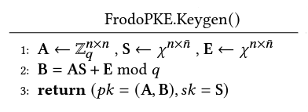
By targeting the locations in RAM where we the LWE secret key and error are stored during the key-generation process, we can use Rowhammer to flip some of the higher-order bits of the LWE secret key material. This in turn, means that the magnitude of certain secret and error coordinates are far higher than would be naturally generated by an honest run.
The effect is that decryption failures become somewhat more likely (not so much for the honest user to know the difference), but an adversary who know precisely which bits were flipped.
While this is the high level overview of our attack exploiting the Rowhammer bug, there’s a lot of issues and complications that needs to be considered to make this approach feasible in a real world scenario. We’ll be discussing those later in this presentation.
Notes:
By targeting the locations in RAM where we the LWE secret key and error are stored during the key-generation process, we can use Rowhammer to flip some of the higher-order bits of the LWE secret key material. This in turn, means that the magnitude of certain secret and error coordinates are far higher than would be naturally generated by an honest run.
The effect is that decryption failures become somewhat more likely (not so much for the honest user to know the difference), but an adversary who know precisely which bits were flipped.
While this is the high level overview of our attack exploiting the Rowhammer bug, there’s a lot of issues and complications that needs to be considered to make this approach feasible in a real world scenario. We’ll be discussing those later in this presentation.

Slide 32
04
Decryption Failure Attack
on Rowhammer-Poisoned FrodoKEM.

Slide 33
This is the part where we combine our decryption failure attack and Rowhammer attack.
But there’s a difference between this attack and a traditional decryption failure attack, as the failure ciphertexts obtained from a traditional decryption failure attack contains a significant amount of information and a few thousand failures is enough to recover the full key, where as in our case, since we have lowered the threshold so much, the failing ciphertexts obtained in our case contains less information.
The failure event occurs orders of magnitude more often for randomly generated ciphertexts, and in turn, the fraction of secret keys that are consistent with a single failure event is far higher. This induces a trade-off in which we require significantly more failing ciphertexts to gain enough information to recover the key, but require less computation overall, since it is much easier to find failing ciphertexts.
It is important to quantify this trade-off, as it informs which specific bits of the public key to target with Rowhammer. Firstly, the effects of Rowhammer on the decryption failure rate is analyzed, which gives us an estimate for the total amount of work required to generate a single failing ciphertext.

Slide 34
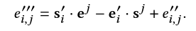
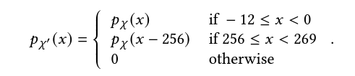
Decryption Failure Rate Analysis:
As from our previous explanation on FrodoKEM, we know that:
M = C2 - C1xS Decode(M) = Decode( Encode(M) + e ) [ e = E′′′ = S′E − E′S +E′′ ]
= Encode(μ) + E’’’
Here, the decoding error is a 8 X 8 Matrix in Frodo640
Also, the decoded message is also an 8 X 8 Matrix if corresponding entry in E’’’ mod q in interval [-4096, 4096) , otherwise the decoded entry is incorrect.
Consider the entry 𝑒ᵢ,ⱼ′′′ at position (𝑖, 𝑗) of E′′′. Let sᵢ′ and eᵢ′ be the 𝑖-rows of S′ and E′ respectively, and eᶨ and sᶨ be the 𝑗-columns of E and S respectively.
𝜒: the error distribution in Frodo. If key generation is executed correctly and eᶨ is sampled from 𝜒𝑛. However, due to row-hammering, the true distribution of eᶨ will be 𝜒′×𝜒𝑛−1, where𝜒′ is defined as: Let 𝑝𝜒:Z→R be the density function of 𝜒. Then, 𝑝𝜒′ is defined by :

Slide 35
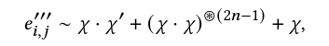
With e𝑗 sampled from 𝜒′ × 𝜒 𝑛−1, an honest encapsulation has decoding error distributed as :

Slide 36
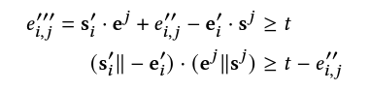
Each failing entry of the error matrix in : E′′′ = S′E − E′S +E′′ gives rise to a linear inequality involving a column from each of S , E , a row from each of S′ , E′ , and the matching coordinate from E′′.
Assuming we exceed the failure threshold 𝑡 in the positive direction, we obtain the following linear inequality:

Slide 37
04
KEY RECOVERY
Completing the Attacks : Session-Key Recovery

Slide 38
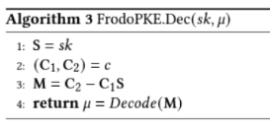
SESSION-KEY RECOVERY
Full secret key may not be recovered (recall, 7 out of 8 columns), but we can still recover the encapsulated session key from honestly generated ciphertexts.
By FO transform: encapsulation is deterministic given the value of u.
In Decap u is decoded from M, but M is not completely known
Solution: Compute an “approximate” M, M’ by filling the missing columns of secret key with 0’s.
Must bruteforce 16 bits of u
Notes:
If we can determine the value of u, we can easily recover the session key.
In FrodoKEM.Decap(), u is decoded from an 8x8 message matrix M, but we cannot calculate M due to lack of our full secret key!
In Frodo-640, the most significant 2 bits of each entry of M are extracted to produce u in FrodoKEM.Decode (resulting in a message size of 128 bits).

Slide 39
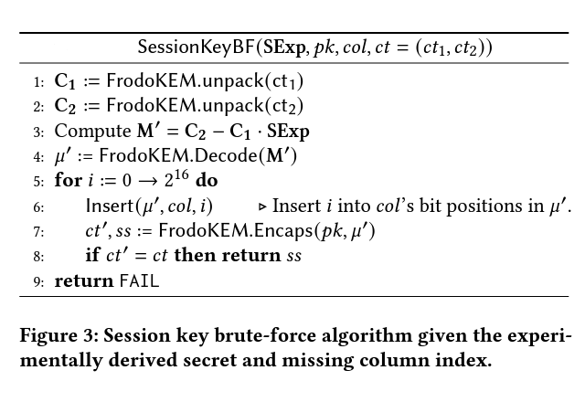
Correct because FO is deterministic: pass 𝜇′ into modified FrodoKEM.Encaps() that accepts 𝜇 as a parameter rather than sampling it at random.
Total cost of the session key recovery:
2^(16 x missing cols) times the cost of FrodoKEM.Encaps()
Brute force algorithm can be run on a standard laptop

Slide 40
05
Possible Countermeasures

Slide 41
Rowhammer Defenses:
Hardware Defenses:
Use Error Correcting Code (ECC) memory
Targeted Row Refresh(TRR) mitigation : TRR is a hardware defense implemented in DDR4 that used counters to keep track of how many times each row in memory is accessed, and once the counter reaches a specified threshold, TRR automatically refreshes the nearby rows.
Software Defenses:
Researchers use performance counters to determine which rows are accessed most frequently, and then refresh those rows before a bit flip occurs.
Algorithmic Defenses:
Limit the surface of the performance degradation through proper sequencing of operation.
Guard the key generation process. I.e., regenerate A, S, and E from randomness and compute B again.
Active Defenses:
Check the distribution of the received ciphertexts during the decapsulation process.
Notes:
: Aims to correct bit flips when they are detected upon reading from memory using “control bits" that act as a checksum, enabling bit correction.
An adversary needs to send a vast number of filtered ciphertexts to mount a successful key recovery attempt. A potential victim could check the distribution of received ciphertexts during the decapsulation process.If the distribution of incoming ciphertexts is skewed towards large values, then it is reasonable to assume that the victim is under attack.

Slide 42
References
When Frodo Flips: End-to-End Key Recovery on FrodoKEM via Rowhammer
Michael Fahr Jr., University of Arkansas
Hunter Kippen, University of Maryland, College Park
Andrew Kwong, University of Michigan–Ann Arbor
Thinh Dang, George Washington University, National Institute of Standards and Technology
Jacob Lichtinger, National Institute of Standards and Technology
Dana Dachman-Soled, University of Maryland, College Park
Daniel Genkin, Georgia Institute of Technology
Alexander Nelson, University of Arkansas
Ray Perlner, National Institute of Standards and Technology
Arkady Yerukhimovich, George Washington University
Daniel Apon, Mitre (United States)

Slide 43
THANKS !
Manasi M. Singhane
Pawan K. Pradhan
mshingan@umd.edu
pawan@umd.edu

